Slide 1
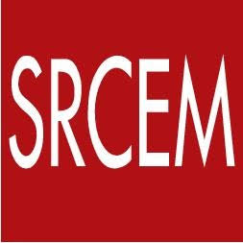
Shri Ram College of Engineering and Management
Department of computer science & Engineering
Presentation On
Cloud Computing
Presented by
Kishan Kumar Rai

Slide 2
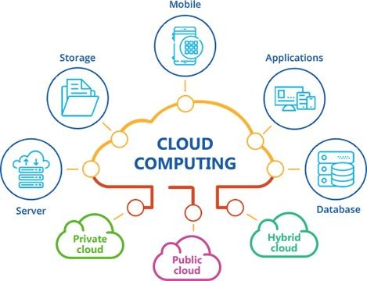
introduction
• What is Cloud ?
• What is Cloud Computing?
• History
• Top Benefits of Cloud Computing
• Simple Examples of Cloud Computing
• Essential Characteristics
• Cloud Computing Architecture
• Cloud Models
• Pros and Cons
• Conclusion

Slide 3
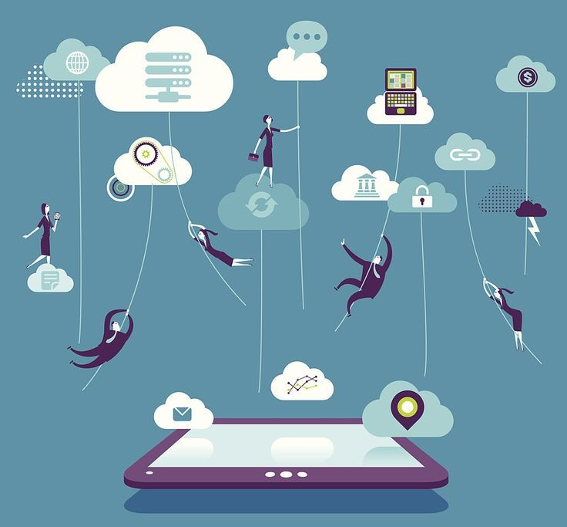
What is Cloud?
In Cloud Computing, the word cloud is used as a metaphor for “ the Internet.” In other words, we can say cloud is something, which is present at remote location.

Slide 4
What is Cloud Computing?
Simply put, cloud computing is the delivery of computing services – servers, storage, databases, networking, software, and analytics and more- over the Internet(Cloud).
Cloud Computing consists of hardware and software resources made available on the internet as they are managed by the third party services. These services typically provides access to advanced software applications, high end networks of server computers.
"You don't generate your own electricity. “Why generate your own computing?”
–Jeff Bezos, Amazon.

Slide 5
History
It was a gradual evolution that started in the 1950s with mainframe computing
After some time, around 1970, the concept of virtual machines (VMs) was created.
In 1999, Salesforce.com started delivering of applications to users using a simple website.
In 2002 Amazon provided First public cloud AWS (Amazon Web Service) , providing services like storage, computation.
In 2009, Google Apps also started to provide cloud computing enterprise applications.
In 2009, Microsoft launched Windows Azure, and companies like Oracle and HP have all joined the game. This proves that today, cloud computing has become mainstream.

Slide 6
Benefits of cloud computing
• Accessibility
• Productivity
• Scalability
• Access to automatic updates
• Business Continuity (Back up & Recovery)
• Pay structure

Slide 7
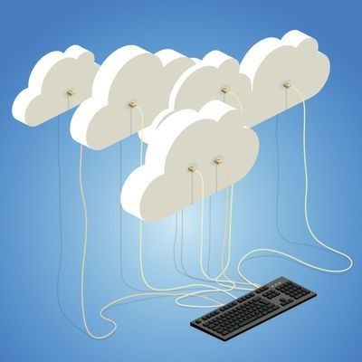
Common Cloud Characteristics
• On Demand Self Service
• Broad network access
• Multi-Tenancy (Resource Pooling)
• Rapid Elasticity
• Measured service

Slide 8
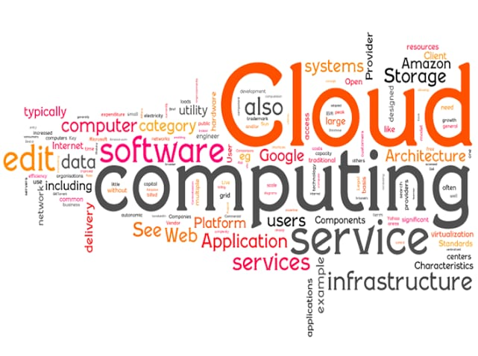
Cloud Models
• Deployment Models
• Service Models

Slide 9
Deployment Models
A cloud deployment model represents a specific type of cloud environment, primarily distinguished by ownership, size, and access.
There are three common cloud deployment models:
Public cloud
Private cloud
Hybrid cloud

Slide 10
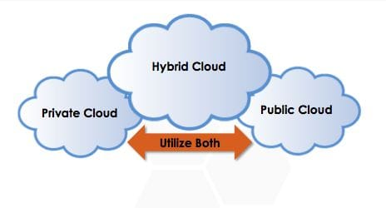
Deployment Models
Public Cloud: Public clouds are owned and operated by a third party cloud service provider, which deliver their computing resources like servers and storage over the internet. As the name suggests, Public cloud is open to public. Anyone can access and use it by paying accordingly

Slide 11
Deployment Models
Private Cloud: The private cloud is defined as computing services offered either over the Internet or a private internal network and only to select users instead of the general public. ... So private clouds require the same staffing, management and maintenance expenses as traditional datacenter ownership
Hybrid Cloud: Hybrid cloud is a cloud computing environment that uses a mix of on-premises, private cloud and third-party, public cloud services with orchestration between the two platforms.

Slide 12
Service Models
In the world of cloud computing, there are three different approaches to cloud-based services:
Infrastructure as a Service (IaaS)
Platform as a Service (PaaS)
Software as a Service (SaaS)

Slide 13
Service Models
Infrastructure as a service (IAAS): is a form of cloud computing that provides virtualized computing resources over the internet.
Key features :
Instead of purchasing hardware outright, users pay for IaaS on demand.
Infrastructure is scalable depending on processing and storage needs.
Saves enterprises the costs of buying and maintaining their own hardware.
Because data is on the cloud, there is no single point of failure.

Slide 14
Service Models
Platform as a service (PaaS): is a cloud computing model in which a third party provider delivers hardware and software tools usually those needed for application development– to user over the internet .
Key features :
PaaS provides a platform with tools to test, develop, and host applications in the same environment.
Enables organizations to focus on development without having to worry about underlying infrastructure.
Providers manage security, operating systems, server software, and backups.
Facilitates collaborative work even if teams work remotely

Slide 15
Service Models
Software as a service (SaaS): is a software distribution model in which a third party provider hosts application and makes them available to customers over the internet
Key features
SaaS vendors provide users with software and applications on a subscription model.
Users do not have to manage, install, or upgrade software; SaaS providers manage this.
Data is secure in the cloud; equipment failure does not result in loss of data.
Use of resources can be scaled depending on service needs

Slide 16
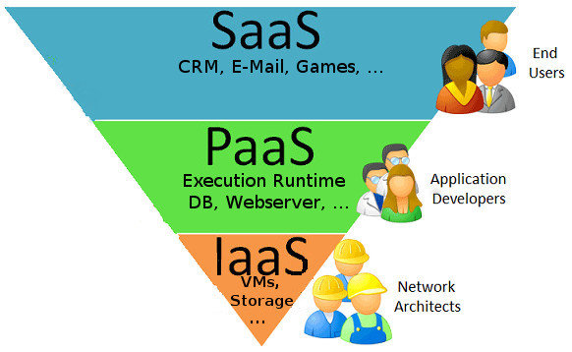
Service Models

Slide 17
Pros and Cons
Pros:
Reduced hardware equipment for end-users
Improved performance
Lower H/W and S/W maintenance
Instant software updates
Accessibility
Metered services
Less expensive
Improved Disaster Recovery
Cons:
Requires good internet speed with good bandwidth
Security
Limited control on Infrastructure

Slide 18
Conclusion
Cloud computing has quickly become one of the most prominent buzzwords in the IT world due to its revolutionary model of computing as a utility. It promises increased flexibility, scalability, and reliability, while promising decreased operational and support costs
Despite the potential gains achieved from the cloud computing, the organizations are slow in accepting it due to security issues and challenges associated with it. Security is one of the major issues which hamper the growth of cloud. The idea of handing over important data to another company is worrisome; such that the consumers need to be vigilant in understanding the risks of data breaches in this new environment.

Slide 19
Thank You

